Slide 1
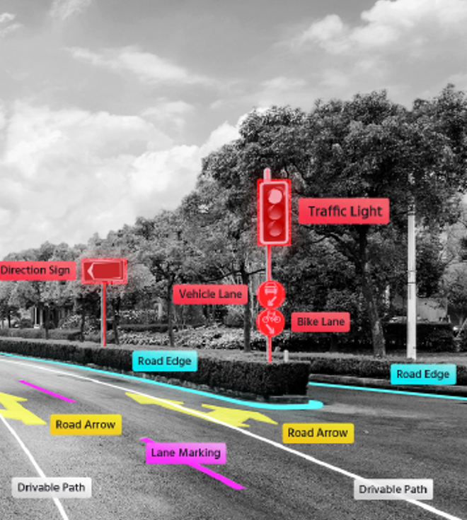

  Expansion of AI for Asset Mgmt.
  Connected vehicle cameras
  Edge computing
  Artificial intelligence (AI)
  Crowd-sourced strategies
  Asset mapping in near-real time
  Asset inventories
  Missing / damaged assets
  Condition assessment

Slide 2
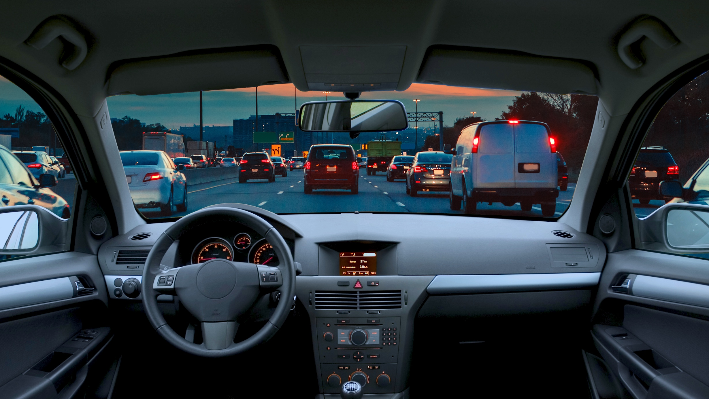
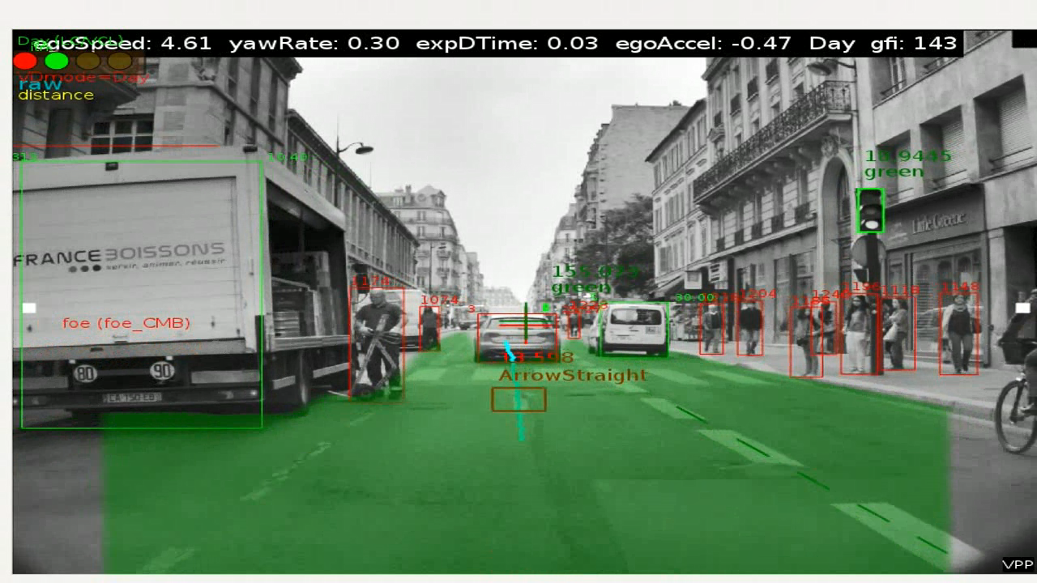
Imagine if you could understand your roads in near-real time…

Slide 3
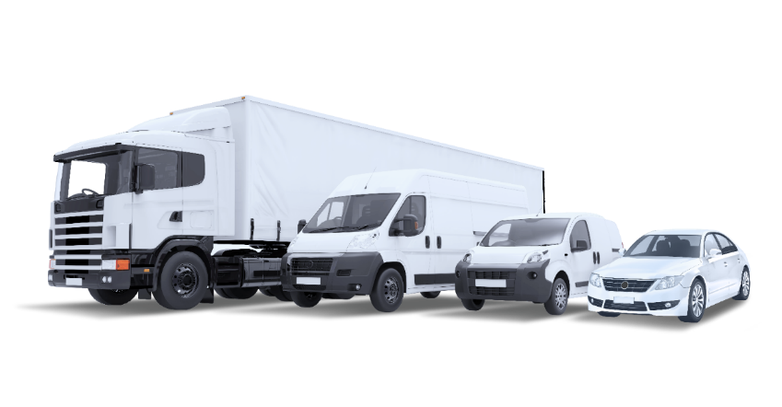

























Connected Vehicles with camera-based systems
Over 150M Vehicles

Slide 4
Connected vehicles bring opportunity for insights
With two main types of crowd-sourced roadway data
Roadway Observations
Road geometries
Traffic control devices
Lane and road markings
Work-zones
Road hazards
Vehicle Headway
VRU (Ped & Cycle counts)
Near-Collisions
etc …
Vehicle Info / Telematics
GPS Trace / Trajectory
Speed
Acceleration
Braking
Traction control
Windshield wiper status
Fuel consumption
Vehicle Type
etc …
The TRB 2022 Annual

Slide 5
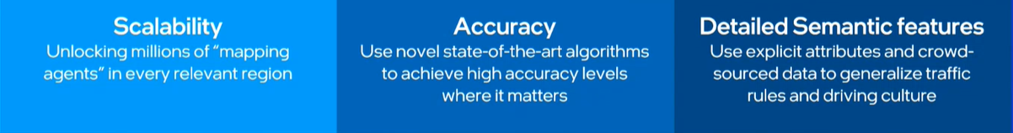
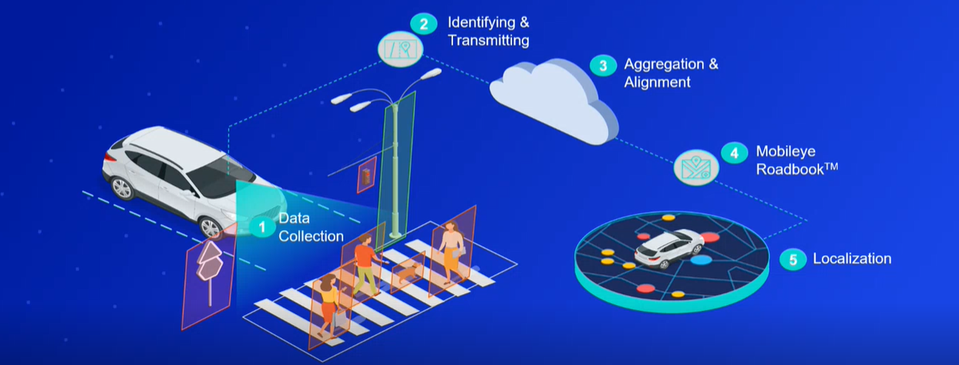
Cost Effective Crowdsourced Mapping

Slide 6




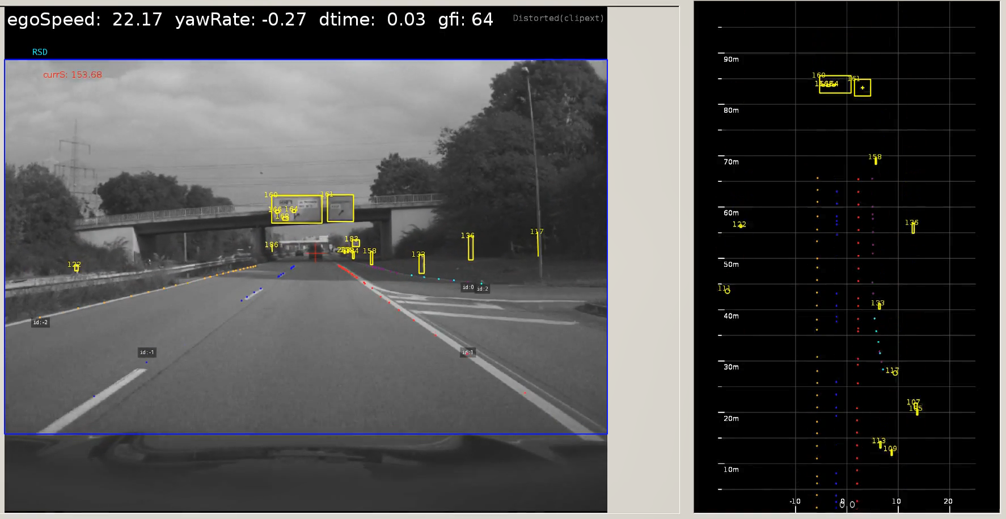
How It Works - Collection
1
Collecting anonymized data through millions of consumer and commercial vehicles
Notes:
This is how it works.
[1. Harvesting]
Vehicles equipped with Mobileye technology scan the road ahead, capture information about what they see and send it to the cloud.
For example, let’s say we have a vehicle equipped with our vision system that drives by a traffic light. Based on computer vision and AI, the system scans the traffic light, extracts the relevant information, packages that data and then sends it to the Mobileye cloud.
I want to point out that we do not upload any video; the relevant metadata is extracted on-the-go and sent to the cloud. By relevant information I mean – the type of asset: traffic light, the dimension details of the traffic light box and its location.

Slide 7

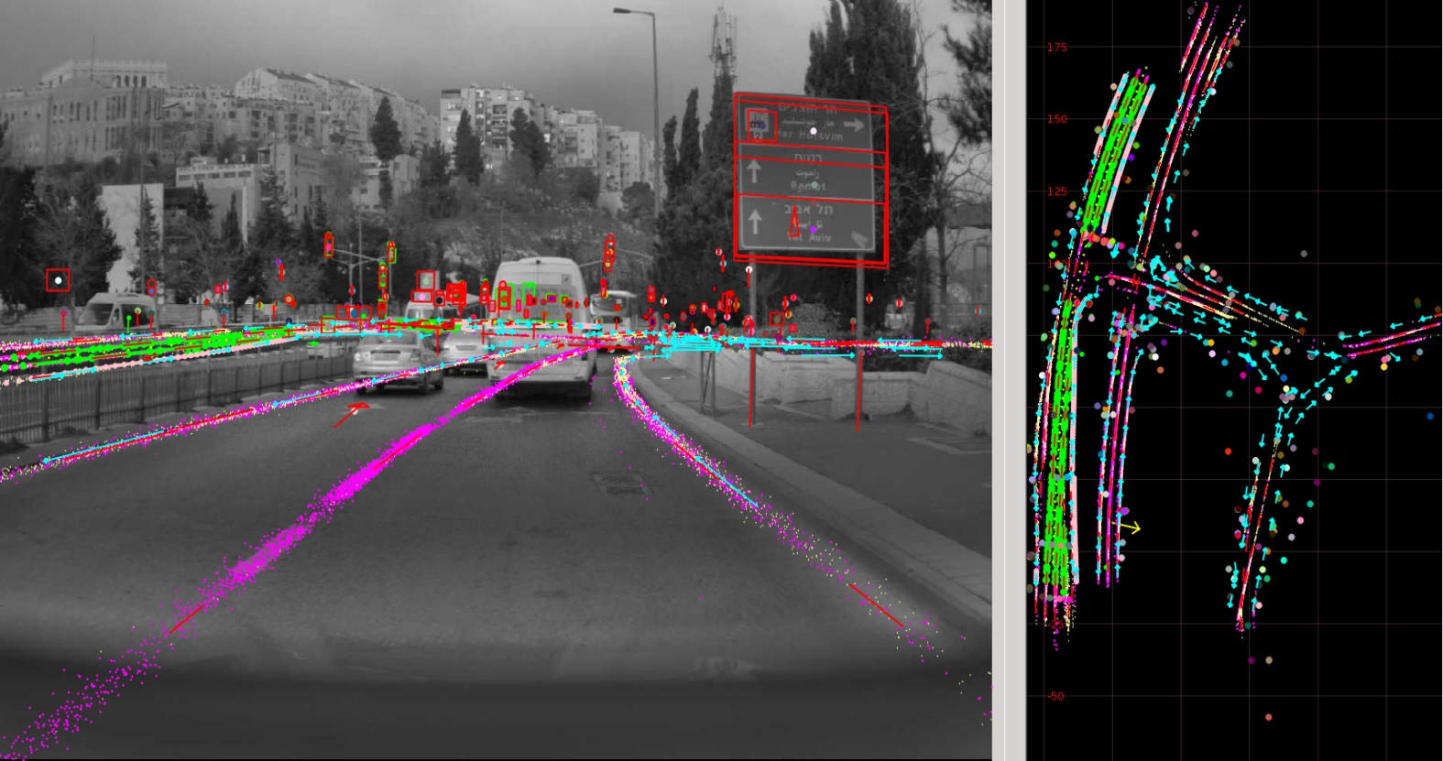
How It Works - Processing
2
Aggregation, clustering & alignment in the cloud
Notes:
[2. Anonymization & Aggregation]
The data is aggregated from multiple drives, clustered, and aligned in the cloud. A certain number of drives – approx. 20 passes per lane - is necessary for this process.
It is important to note that no personal data is collected, the process is fully GDPR-compliant, all around the world.

Slide 8
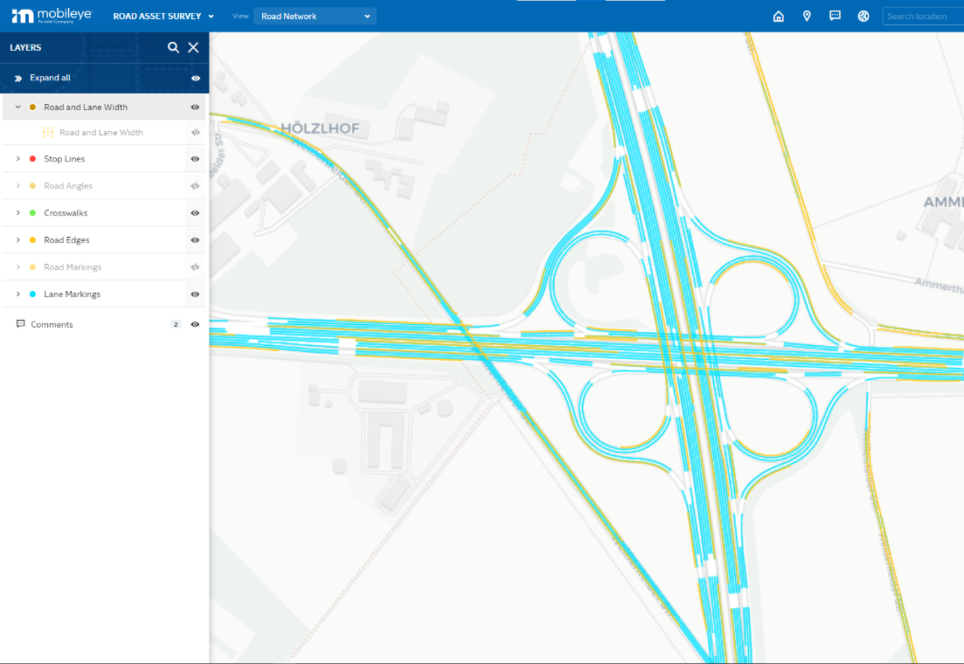
How It Works - Mapping
Notes:
[2. Anonymization & Aggregation]
The data is aggregated from multiple drives, clustered, and aligned in the cloud. A certain number of drives – approx. 20 passes per lane - is necessary for this process.
It is important to note that no personal data is collected, the process is fully GDPR-compliant, all around the world.

Slide 9
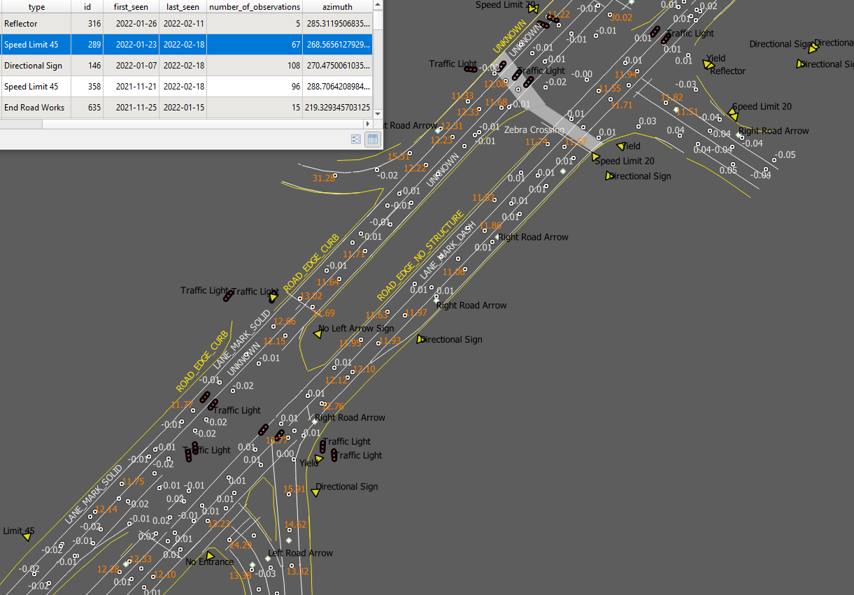
Rich Map Details
Road Furniture
Traffic Lights
Traffic Signs
Road Edges
Pavement Markings
Road Markings
Lane Markings
Crosswalks
Stop Lines
Geometry
Road & Lane Widths
Slope
Curvature
`
INFRASTRUCTURE MAPS
Align to local GIS and LRS maps
Potential to address MIRE Reporting
Before/After assessment
Change detection over time
Engineering & Safety planning
Notes:
[2. Anonymization & Aggregation]
The data is aggregated from multiple drives, clustered, and aligned in the cloud. A certain number of drives – approx. 20 passes per lane - is necessary for this process.
It is important to note that no personal data is collected, the process is fully GDPR-compliant, all around the world.

Slide 10
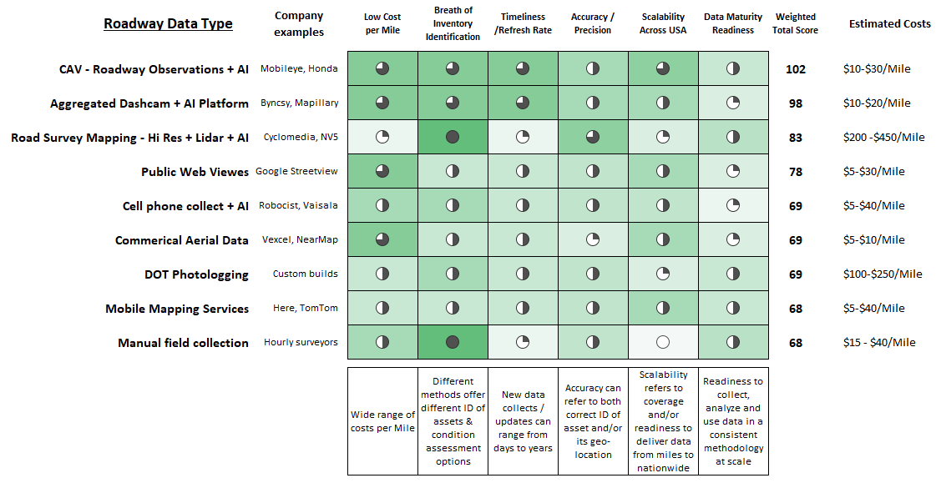
Simple Cost Analysis of Roadway Asset Information

Slide 11
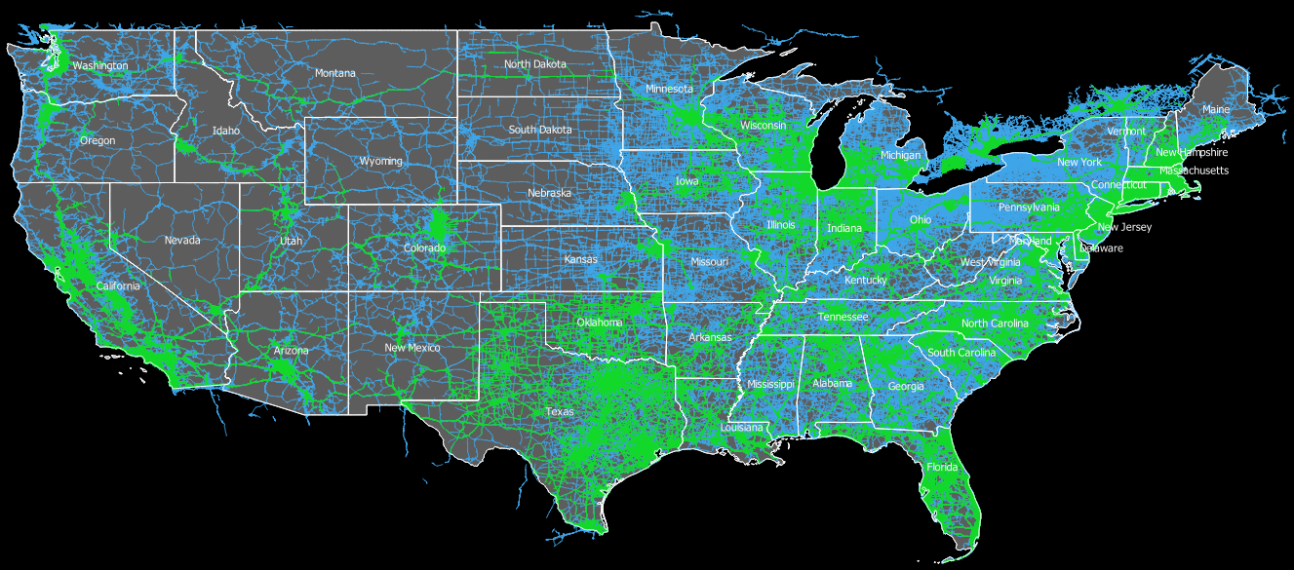
Example of CAV-Vision Based Data Coverage
October 1 – December 31, 2021
Mobileye equipped OEM vehicles
Mobileye equipped Fleet vehicles
The TRB 2022 Annual
Automated Rad Transportation Symposium

Slide 12
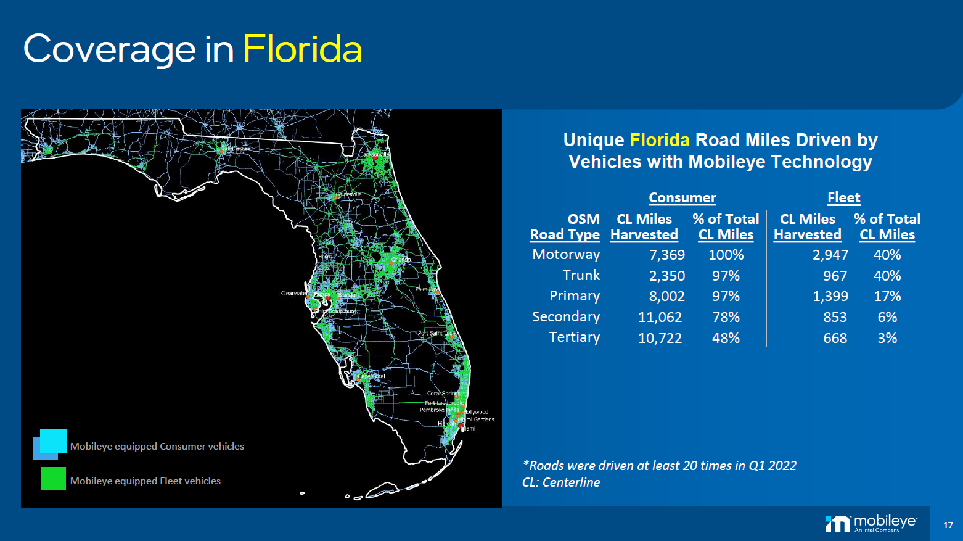

Slide 13
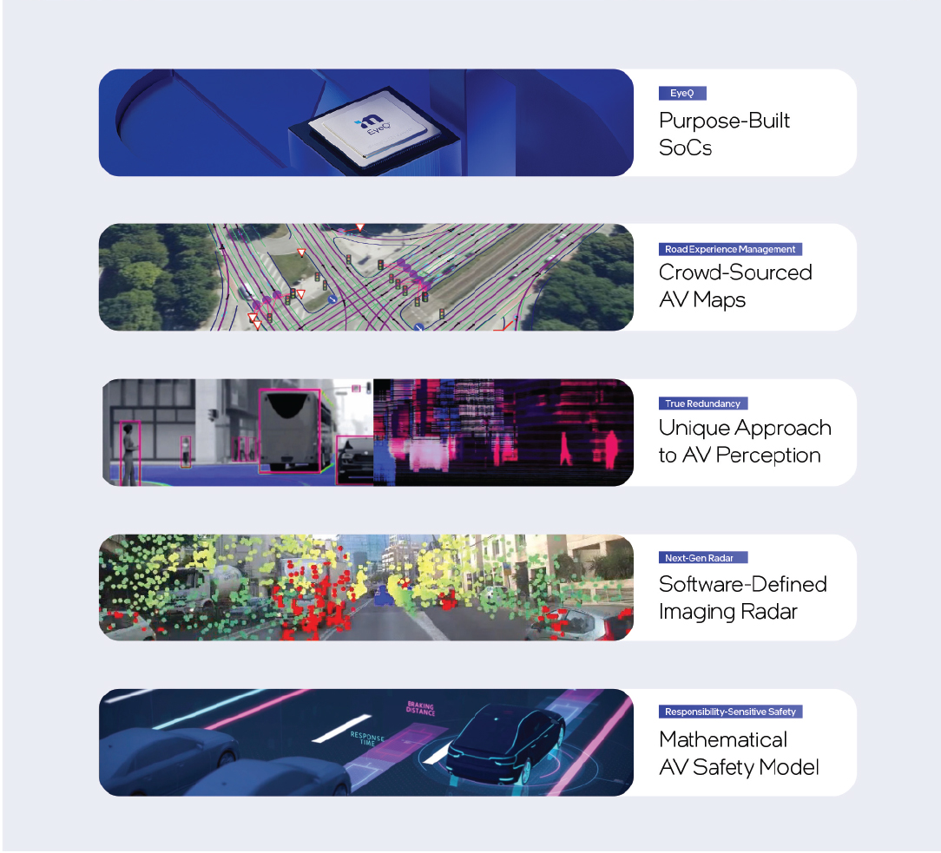
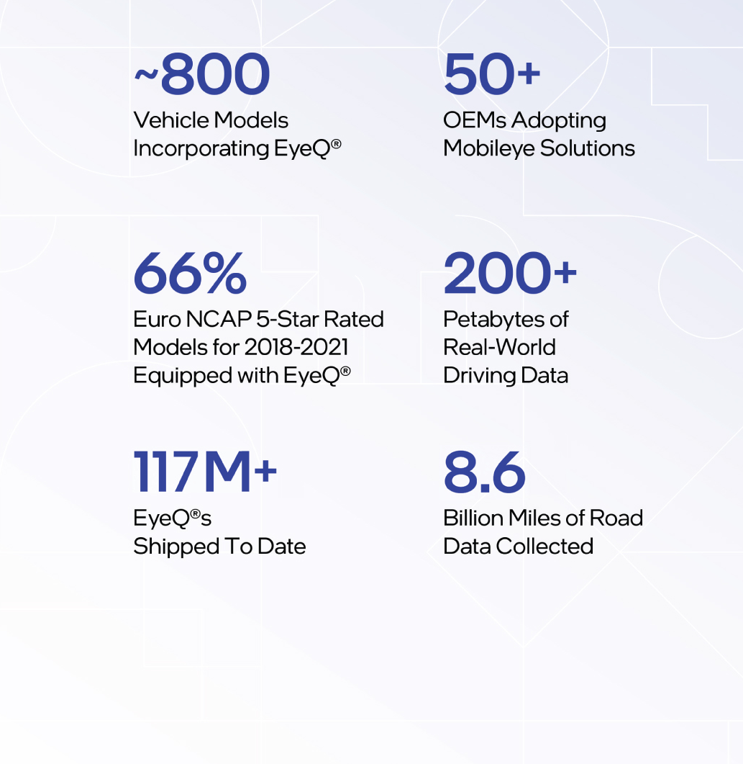
Two Decades of Road Tested ADAS
1.5M+
REM-enabled vehicles
43M
Miles of roads harvested daily
Notes:
SUMMARY as of SEC filing, dated Sep 30, 2022
117M EyeQ chips sold
~800 vehicle models incorporate EyeQ
50+ OEMs adopting Mobileye solutions
1.5M REM-enabled vehicles (REM™ mapping capability launched in 2018)
8.6+ billio43M miles analyzed daily n miles of road data collected (8.6B was as of July 2, 2022)
- not clear if these are unique miles DAILY (I think they are. But I would also think they are not unique day-to-day. NEED TO CHECK).
Coverage: 90% of approx. 0.8M miles of U.S. motorway, trunk, and primary road types

Slide 14
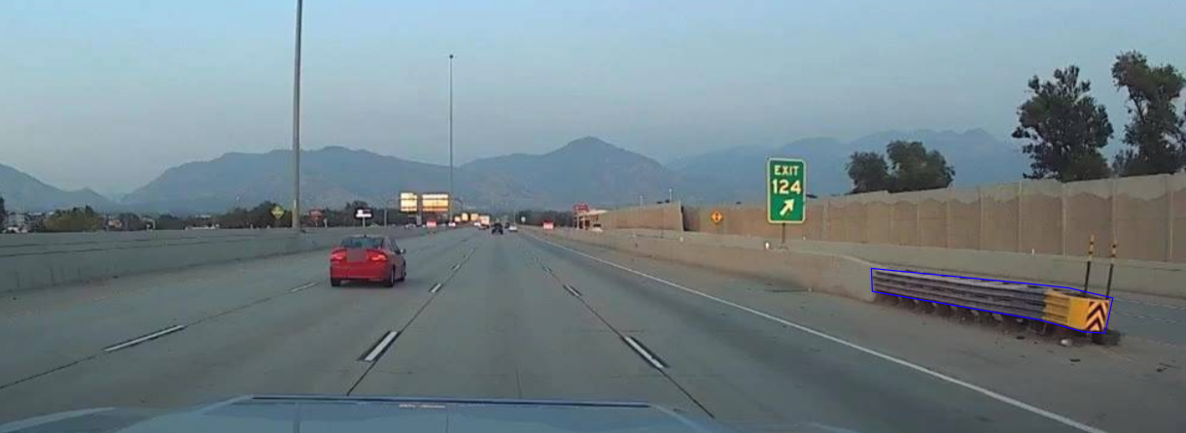
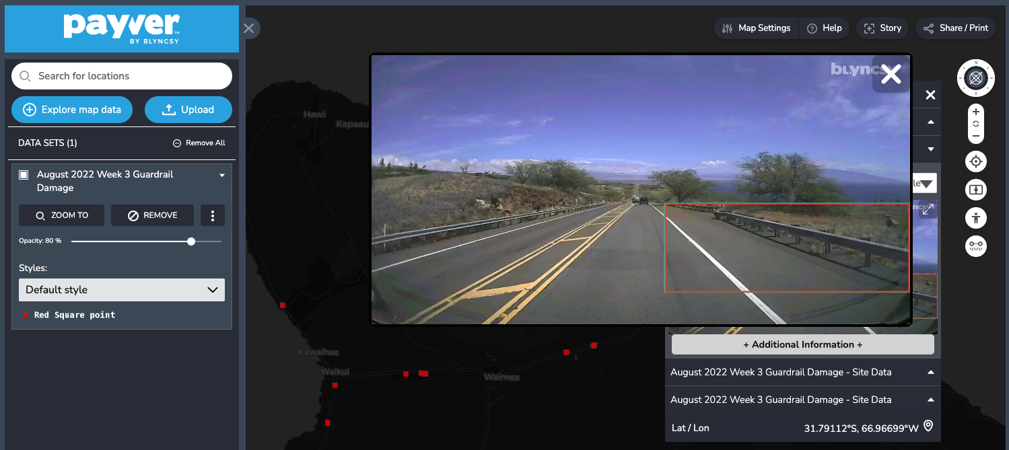
Impact Attenuators and Guardrails
Knowing is half the battle. Automated detection and notifications of damaged attenuators and guardrails let you know there's an issue before there is an issue.

Slide 15
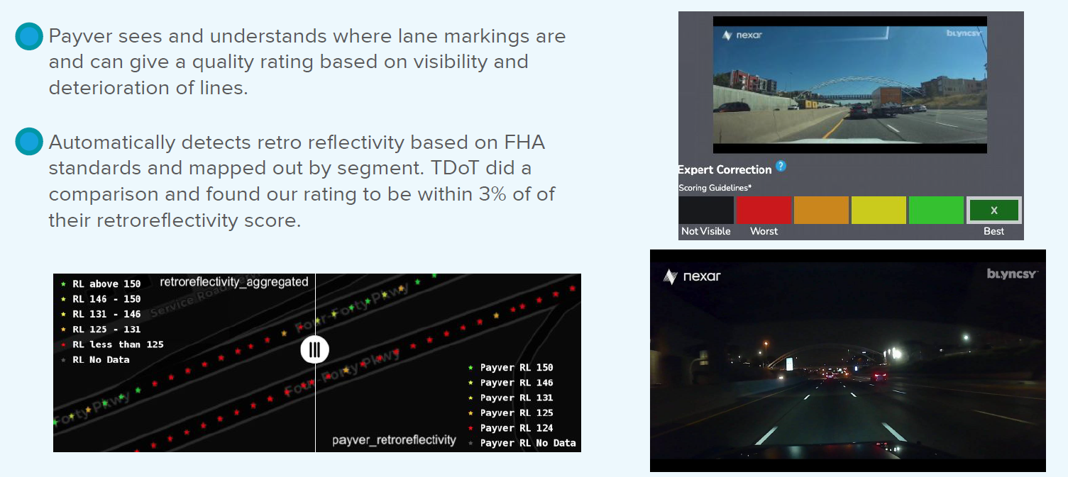
Pavement Markings

Slide 16
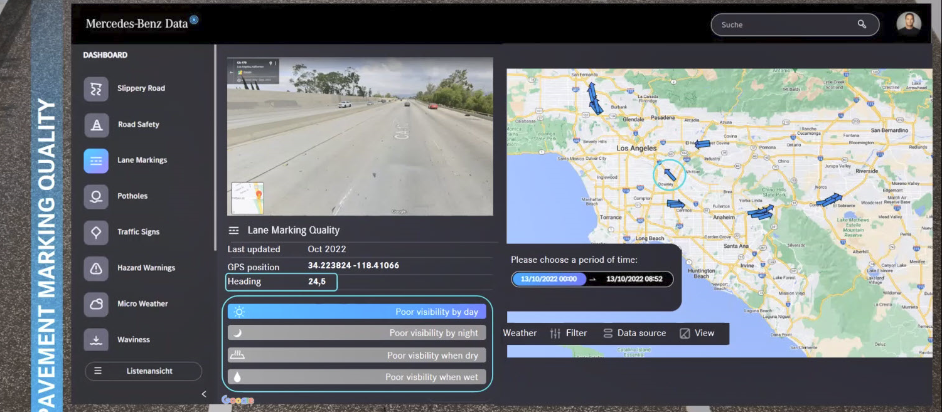
Pavement Markings

Slide 17
Thank You
Paul Carlson, PhD, PE
Automated Roads | CEO
A Woman-Owned Small Business
paul@automatedroads.com
Special thanks to:
Mobileye
Bl.yncsy
Mercedes Benz
GM

